Slide 1

ONLINE RECRUITMENT SYSTEM
Developed By :- Rishab Gandhar
Roll Number :- 2010CSA1738
B.Tech. CSE 8th Semester

Slide 2
ONLINE RECRUITMENT SYSTEM
Index :-
Introduction
Features
Front End
Back End
Hardware Requirements
Software Requirements

Slide 3
ONLINE RECRUITMENT SYSTEM
Introduction:-
Platform to facilitate the interaction between Recruiter and Aspiring students for effective hiring process on the part of both Employee and Employer.
Web and Mobile based platform to provide opportunities to unplaced and placed candidates and a hassle free tool for Recruiters to boost up their recruiting process, in order to benefit both ends.

Slide 4
ONLINE RECRUITMENT SYSTEM
Features :-
Sign up and Login for Recruiter and Aspiring Employee.
Automatic forwarding of profile from credentials entered by student.
Online mock test for Aspiring Students and result display at websites for them to access.
Mobile Application on Android platform for Aspiring candidates for portable access to main website.
Company profiles of different companies and their portfolios for Candidates to access.

Slide 5


ONLINE RECRUITMENT SYSTEM
Front End :-
Java
Android

Slide 6

ONLINE RECRUITMENT SYSTEM
Back End :-
MySQL

Slide 7
ONLINE RECRUITMENT SYSTEM
Hardware Requirements :-
Pentium 4 Computer
512 MB RAM (Minimum)
High Speed Internet Connection

Slide 8
ONLINE RECRUITMENT SYSTEM
Software Requirements :
Any Operating System (Windows, Linux, MAC)
Java Run Time environment
Netbeans / Eclipse (Java IDE)
Java SDK (Software Development Kit)
Android Development Toolkit (ADT)
Any web browser(Chrome , Firefox , etc)

Slide 9
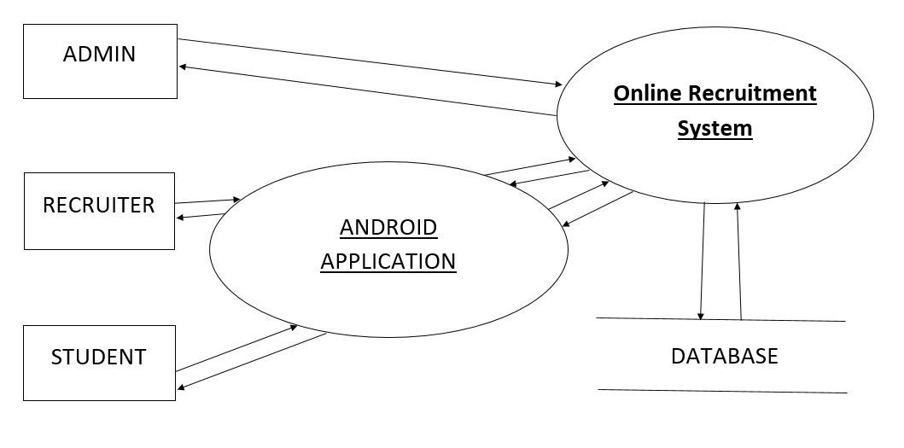
ONLINE RECRUITMENT SYSTEM
Level 0 DFD for Online Recruitment System

Slide 10
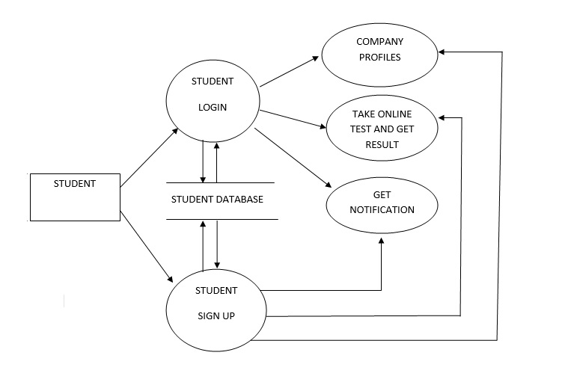
ONLINE RECRUITMENT SYSTEM
Level 1 DFD for Student Side in Online Recruitment System

Slide 11
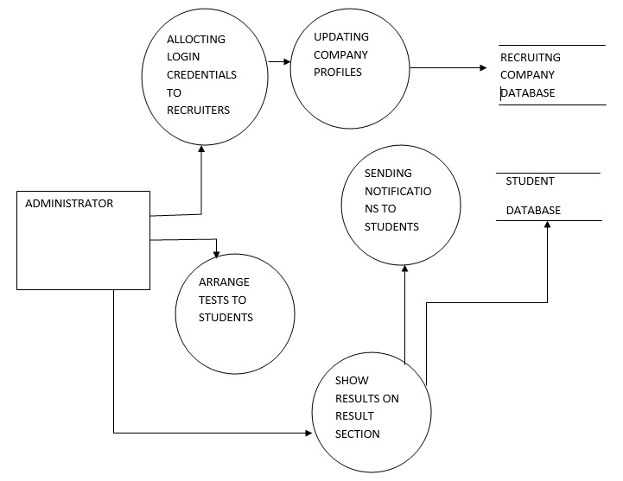
ONLINE RECRUITMENT SYSTEM
Level 1 DFD for Admin Side in Online Recruitment System

Slide 12
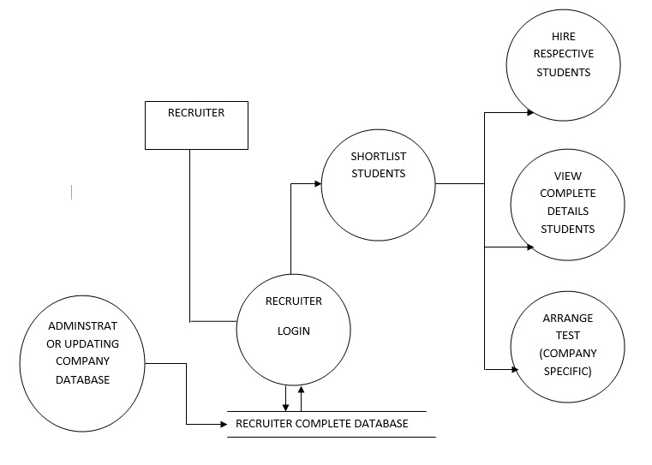
ONLINE RECRUITMENT SYSTEM
Level 1 DFD for Recruiter Side in Online Recruitment System

Slide 13
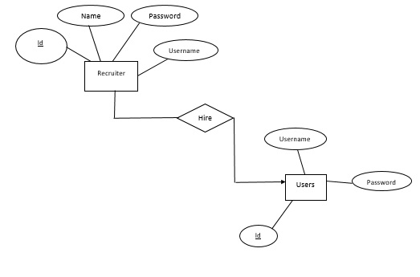
ONLINE RECRUITMENT SYSTEM
ER Diagrams for Online Recruitment System

Slide 14
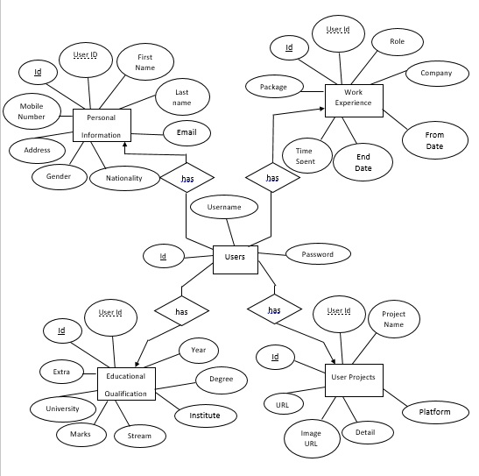
ONLINE RECRUITMENT SYSTEM

Slide 15
ONLINE RECRUITMENT SYSTEM
Database Tables for Online Recruitment System
1. Recruiters
FIELD | DATATYPE | CONSTRAINTS | DESCRIPTION
Id | INT | Primary key | Store Auto Generated ID
Username | VARCHAR(45) | Not Null | Store username given to each recruiter
Password | VARCHAR(45) |  | Store password of each recruiter
Name | VARCHAR(45) |  | Store name of each recruiter

Slide 16
ONLINE RECRUITMENT SYSTEM
Database Tables for Online Recruitment System
2. Users
FIELD | DATATYPE | CONSTRAINTS | DESCRIPTION
Id | INT | Primary key | Store Auto Generated ID
Username | VARCHAR(45) | Not Null | Store username given to each user
Password | VARCHAR(45) |  | Store password of each user

Slide 17
ONLINE RECRUITMENT SYSTEM
Database Tables for Online Recruitment System
3. Personal Information
FIELD | DATATYPE | CONSTRAINTS | DESCRIPTION
Id | INT | Primary key | Store Auto Generated ID
User Id | INT | Foreign key | Store unique id given to each student
First Name | VARCHAR(45) |  | Store First name of student
Last Name | VARCHAR(45) |  | Store Last name of student
Email | VARCHAR(45) |  | Store e-mail id
Nationality | VARCHAR(45) |  | Store Nationality
Gender | CHAR |  | Store Student Gender
Address | INT |  | Store Address
Mobile Number | NUMERIC(12,0) |  | Store Phone Number

Slide 18
ONLINE RECRUITMENT SYSTEM
Database Tables for Online Recruitment System
4. User Projects
FIELD | DATATYPE | CONSTRAINTS | DESCRIPTION
Id | INT | Primary key | Store Auto Generated ID
User Id | INT | Foreign key | Store unique id given to each student
Project Name | VARCHAR(45) |  | Store Role of User
Platform Used | VARCHAR(45) |  | Store name of Company
Details | DATE |  | Store Joining date from ex-company
Image URL | DATE |  | Store Resignation date from ex-company
URL | NUMERIC(3,3) |  | Store Total Time Spent

Slide 19
ONLINE RECRUITMENT SYSTEM
Database Tables for Online Recruitment System
5. Work Experience
FIELD | DATATYPE | CONSTRAINTS | DESCRIPTION
Id | INT | Primary key | Store Auto Generated ID
User Id | INT | Foreign key | Store unique id given to each student
Role | VARCHAR(45) |  | Store Role of User
Company | VARCHAR(45) |  | Store name of Company
For Date | DATE |  | Store Joining date from ex-company
End Date | DATE |  | Store Resignation date from ex-company
Time Spent | NUMERIC(3,3) |  | Store Total Time Spent
Package | NUMERIC(10,5) |  | Store Package

Slide 20
ONLINE RECRUITMENT SYSTEM
Database Tables for Online Recruitment System
6. Educational Qualification
FIELD | DATATYPE | CONSTRAINTS | DESCRIPTION
Id | INT | Primary key | Store Auto Generated ID
User Id | INT | Foreign key | Store unique id given to each student
Year | YEAR |  | Store Year of passing
Degree | INT |  | Store Details of Degree
Institute | INT |  | Store Details of Institute
Stream | VARCHAR(45) |  | Store Degree of Specialization
Marks | NUMERIC(3,3) |  | Store Marks of Degree
University | INT |  | Store name of University
Extra | VARCHAR(45) |  | Store any extra detail about him/her self

Slide 21
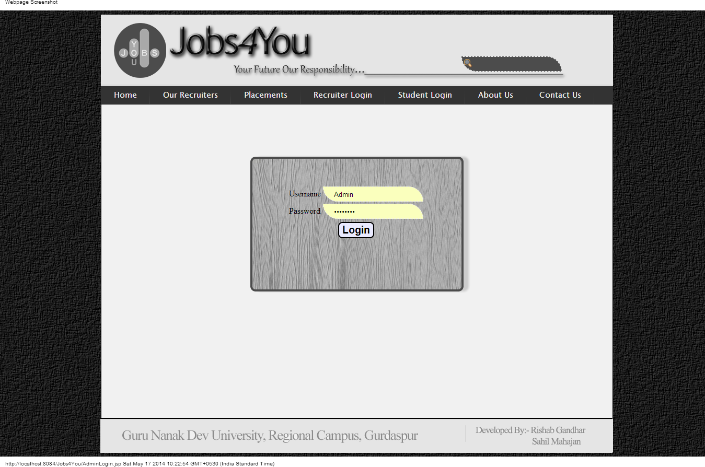
ONLINE RECRUITMENT SYSTEM
Screen Shots for Online Recruitment System
1. Web End(Admin Login Screen)

Slide 22
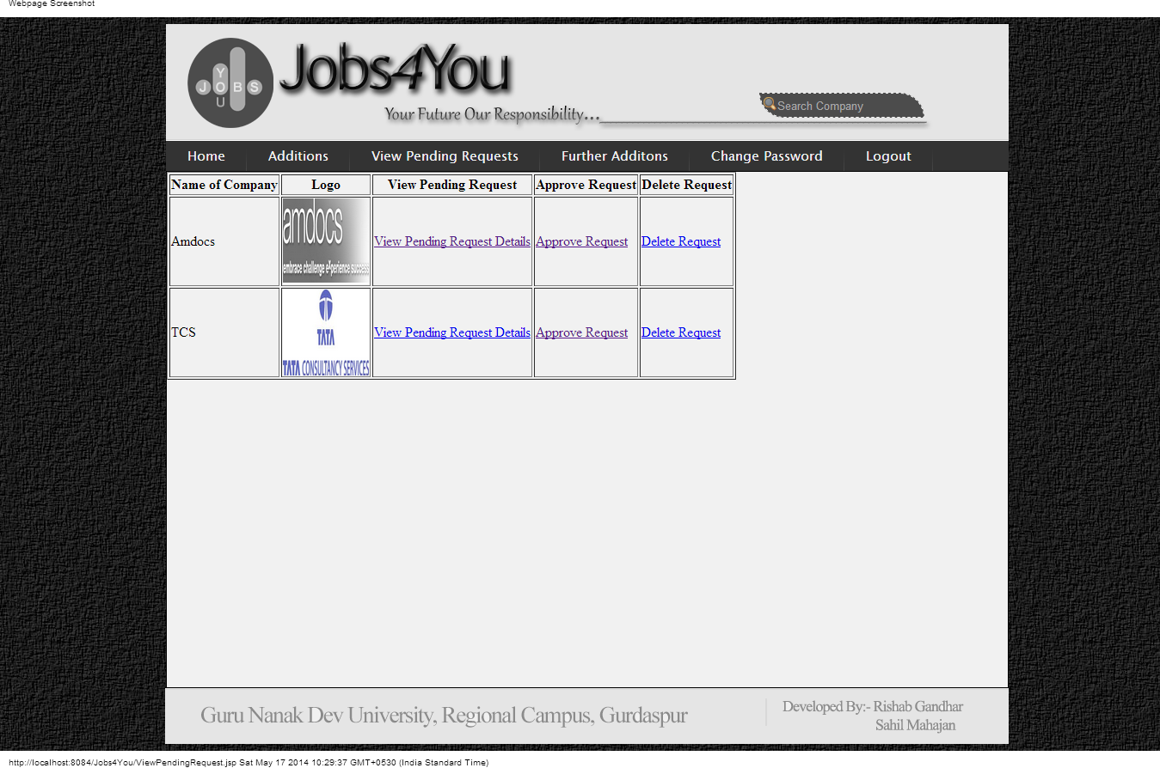
ONLINE RECRUITMENT SYSTEM
Screen Shots for Online Recruitment System
2. Web End(Admin Approving Recruiters Screen)

Slide 23

ONLINE RECRUITMENT SYSTEM
Screen Shots for Online Recruitment System
3. Web End(Home Screen)

Slide 24
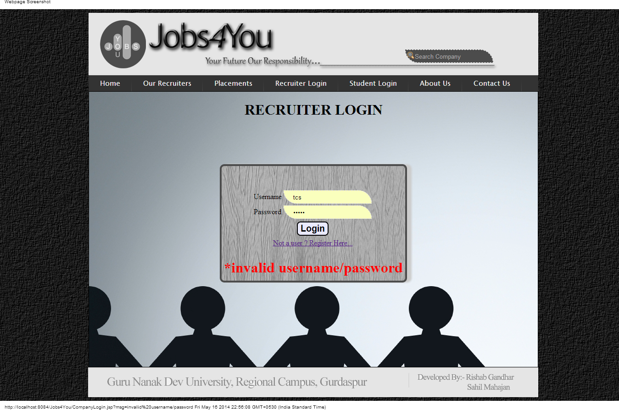
ONLINE RECRUITMENT SYSTEM
Screen Shots for Online Recruitment System
4. Web End(Company Login Screen)

Slide 25
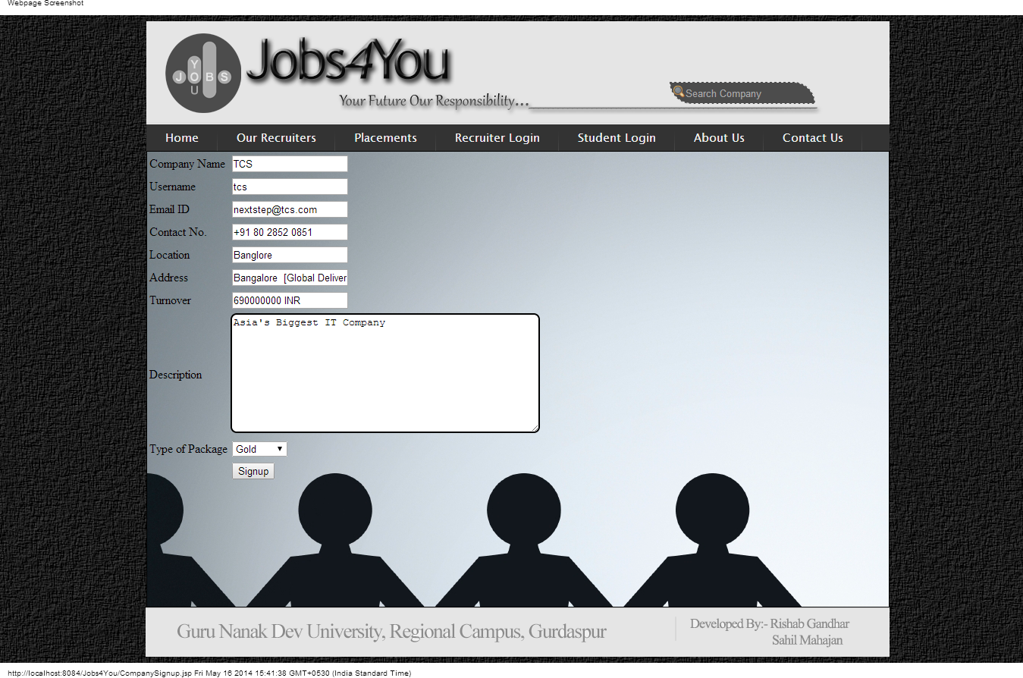
ONLINE RECRUITMENT SYSTEM
Screen Shots for Online Recruitment System
5. Web End(Company Signup Screen)

Slide 26

ONLINE RECRUITMENT SYSTEM
Screen Shots for Online Recruitment System
6. Web End(Company Home Screen)

Slide 27
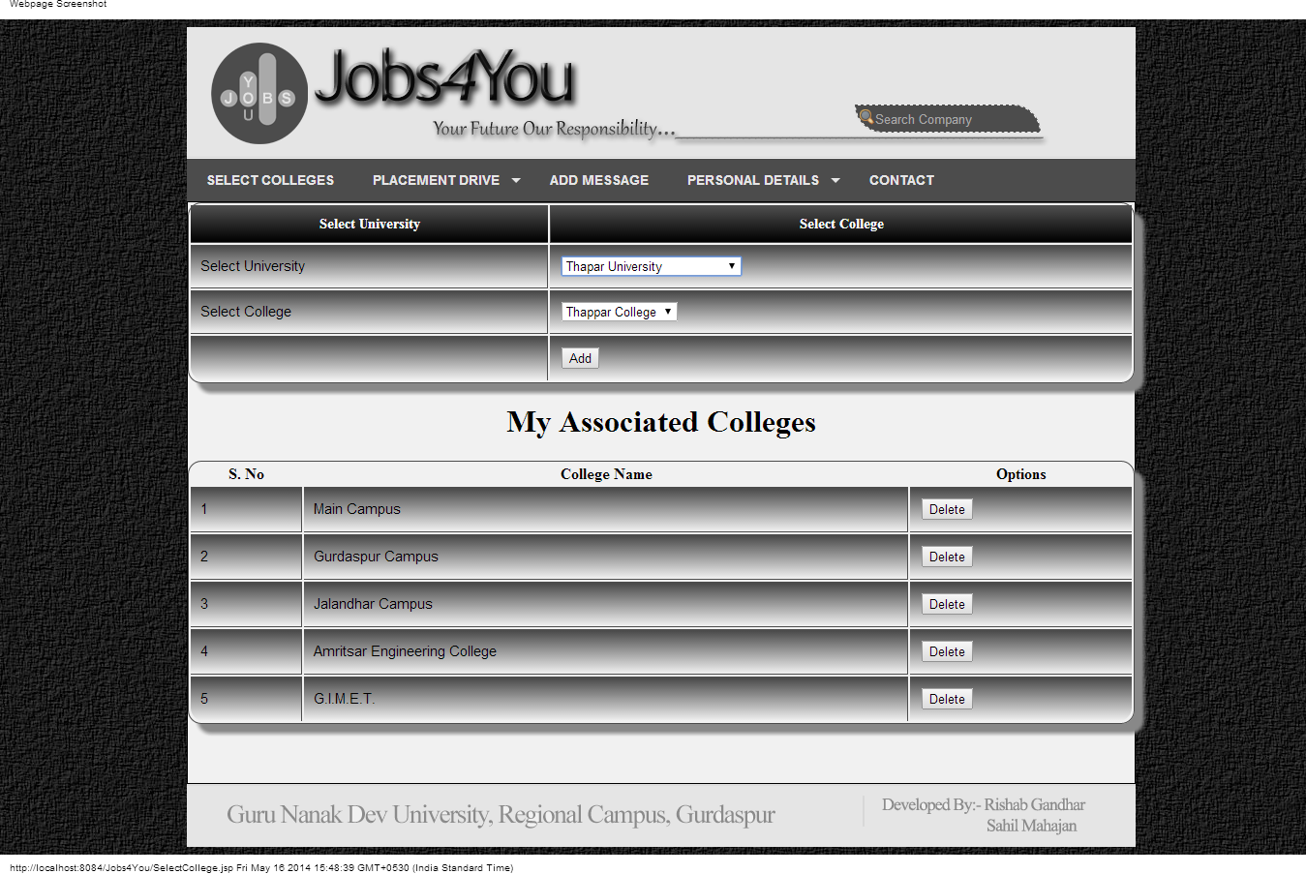
ONLINE RECRUITMENT SYSTEM
Screen Shots for Online Recruitment System
7. Web End(Company Selecting Colleges Screen)

Slide 28
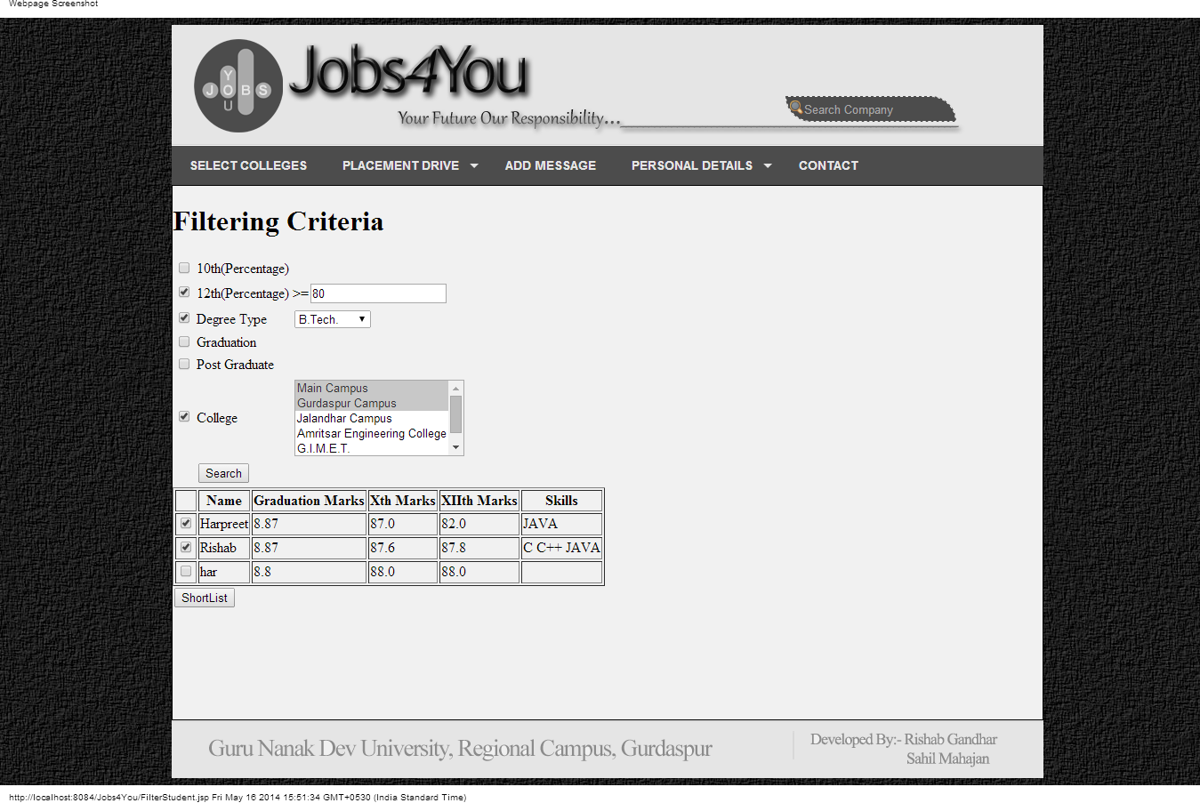
ONLINE RECRUITMENT SYSTEM
Screen Shots for Online Recruitment System
8. Web End(Company Filtering Students Screen)

Slide 29
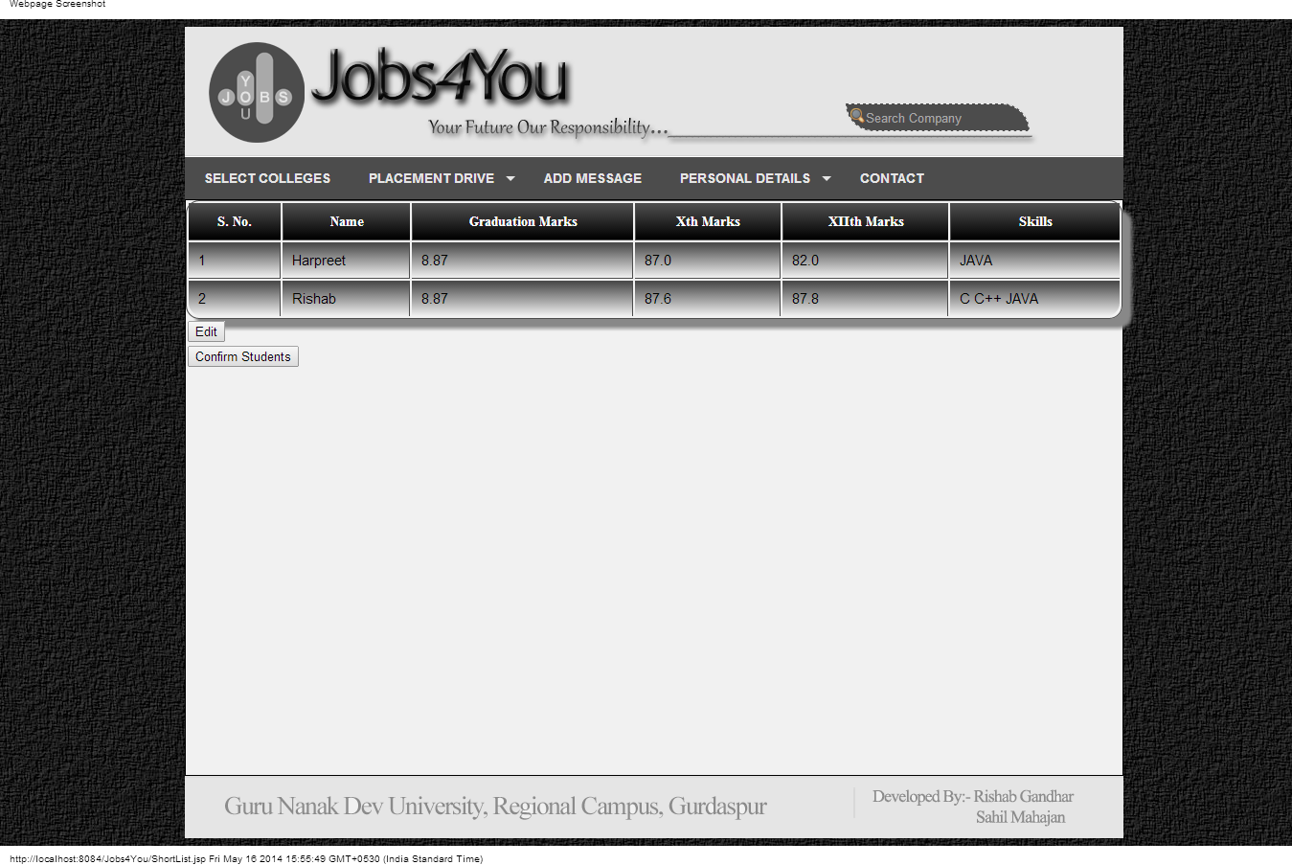
ONLINE RECRUITMENT SYSTEM
Screen Shots for Online Recruitment System
9. Web End(Company Shortlisting Students Screen)

Slide 30
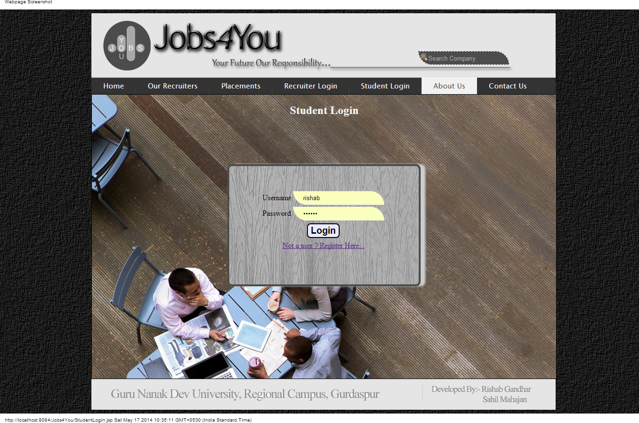
ONLINE RECRUITMENT SYSTEM
Screen Shots for Online Recruitment System
10. Web End(Student Login Screen)

Slide 31
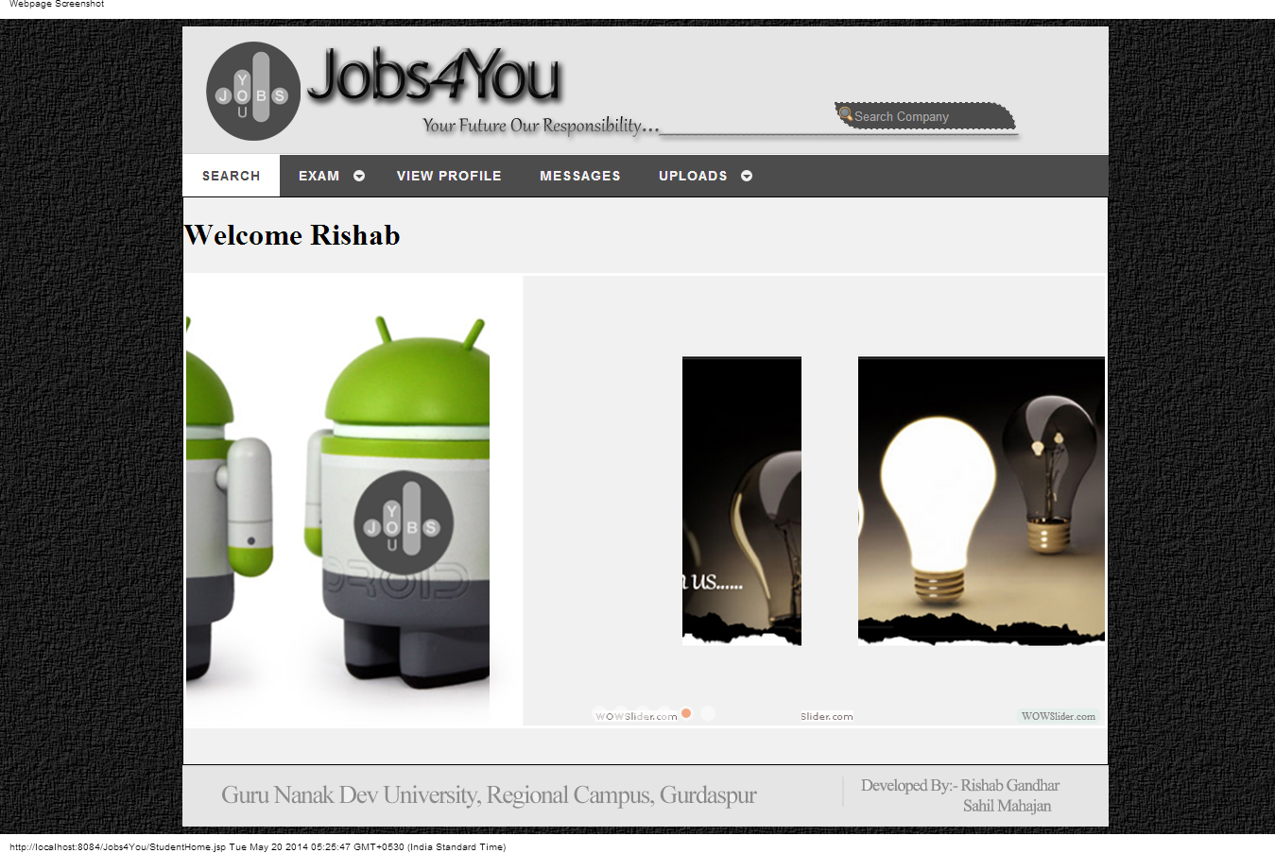
ONLINE RECRUITMENT SYSTEM
Screen Shots for Online Recruitment System
11. Web End(Student Home Screen)

Slide 32
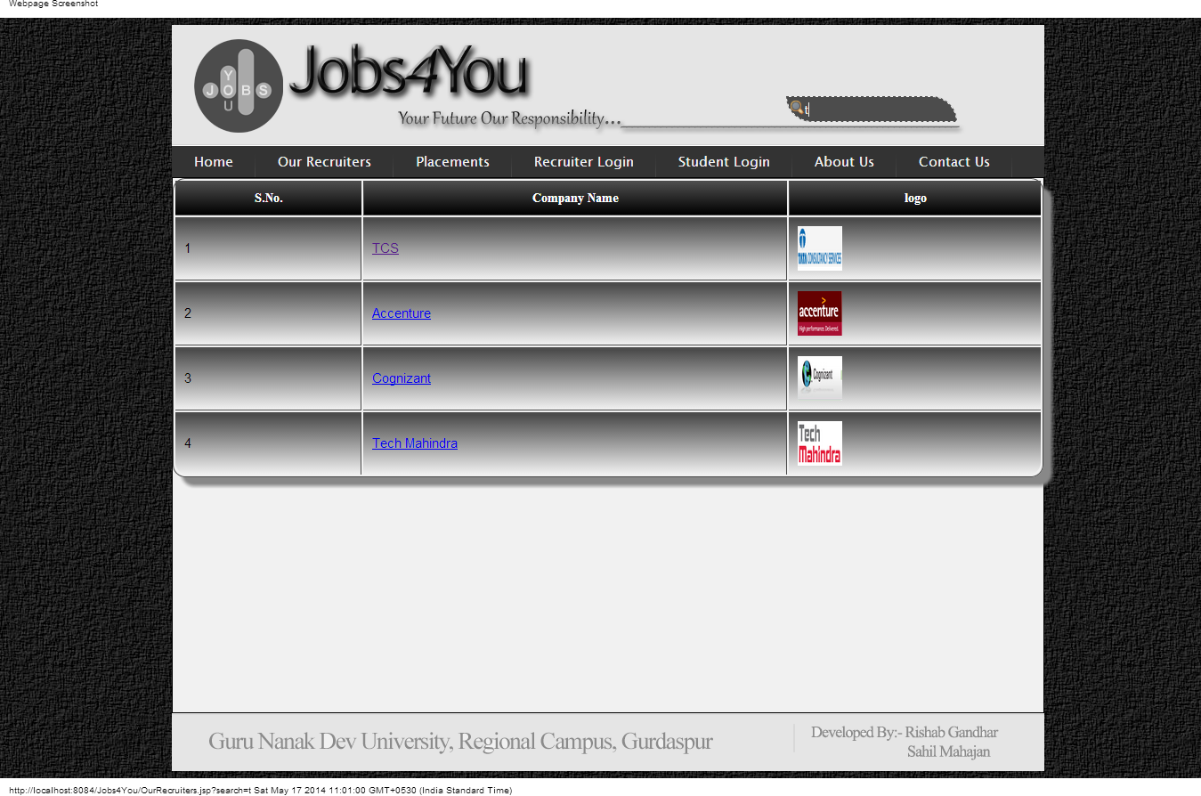
ONLINE RECRUITMENT SYSTEM
Screen Shots for Online Recruitment System
12. Web End(Student Searching Company Screen)

Slide 33
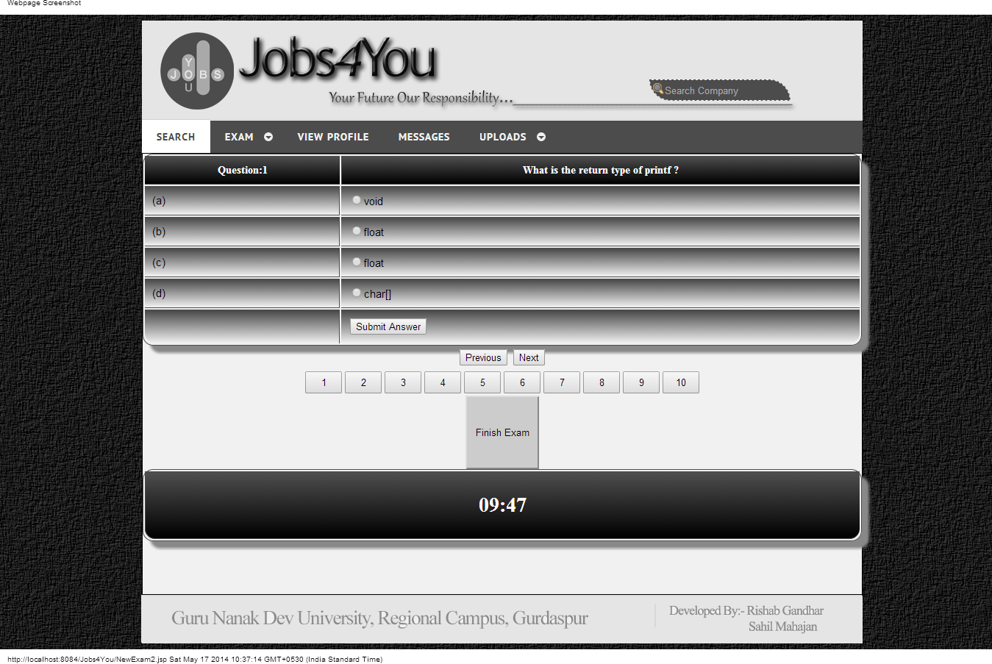
ONLINE RECRUITMENT SYSTEM
Screen Shots for Online Recruitment System
13. Web End(Student Taking Exam Screen)

Slide 34
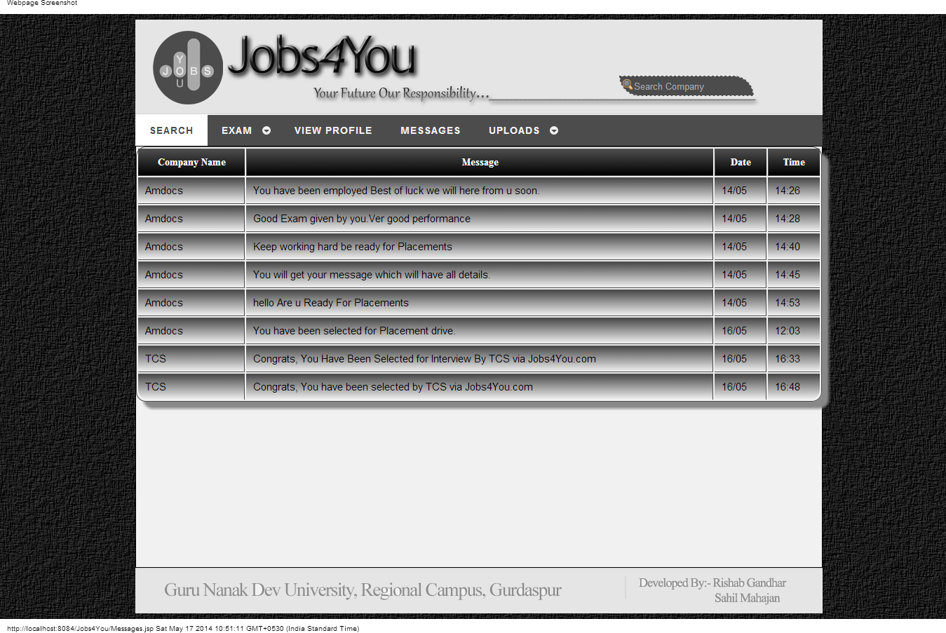
ONLINE RECRUITMENT SYSTEM
Screen Shots for Online Recruitment System
14. Web End(Student Reading Previous Messages Screen)

Slide 35
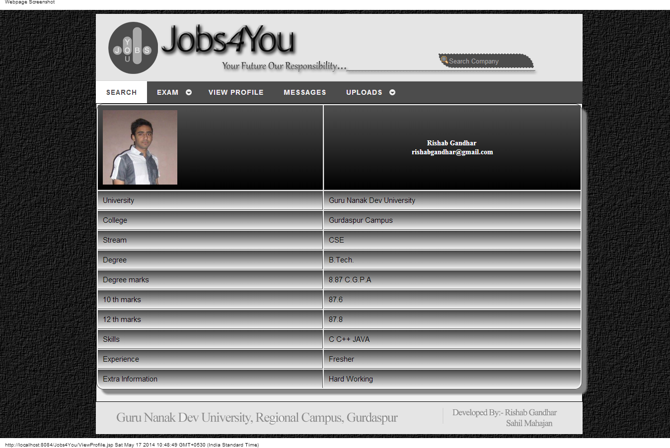
ONLINE RECRUITMENT SYSTEM
Screen Shots for Online Recruitment System
15. Web End(Student Viewing Profile Screen)

Slide 36

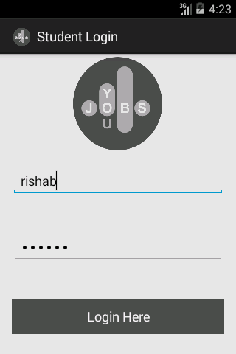
ONLINE RECRUITMENT SYSTEM
Screen Shots for Online Recruitment System
16. Android End (Starting Screen & Student Login)

Slide 37
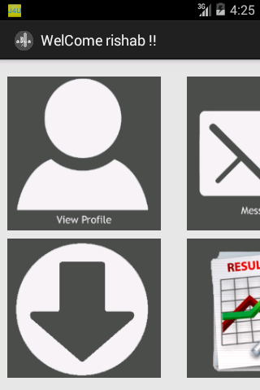


ONLINE RECRUITMENT SYSTEM
Screen Shots for Online Recruitment System
17. Android End (Student Home Screens)

Slide 38
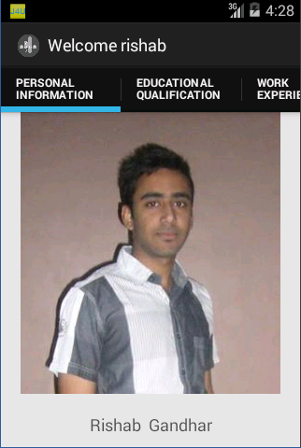

ONLINE RECRUITMENT SYSTEM
Screen Shots for Online Recruitment System
18. Android End (Student Profile & Messages Screens)

Slide 39
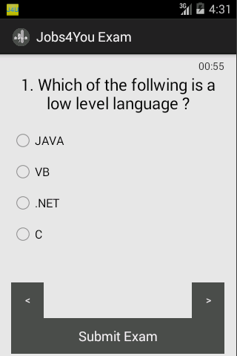
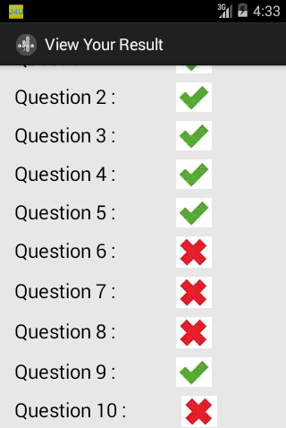
ONLINE RECRUITMENT SYSTEM
Screen Shots for Online Recruitment System
19. Android End (Student Taking Test Screens)

Slide 40
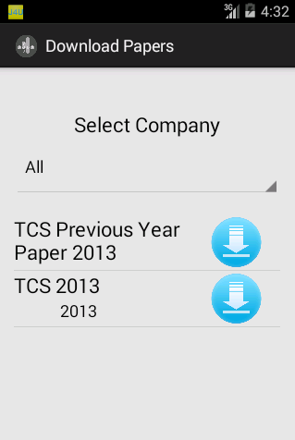
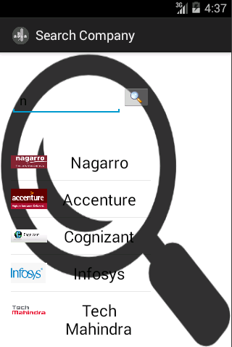
ONLINE RECRUITMENT SYSTEM
Screen Shots for Online Recruitment System
20. Android End (Student Downloading Papers & Searching Screens)

Slide 41
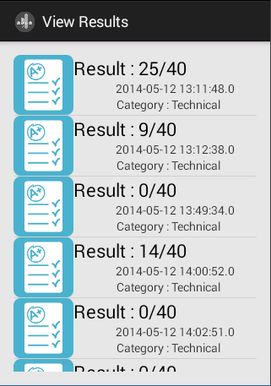
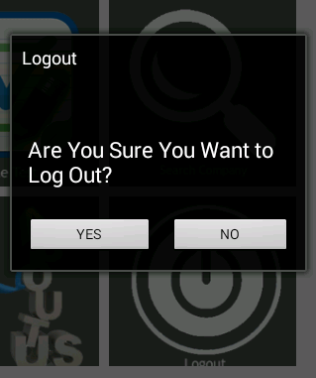
ONLINE RECRUITMENT SYSTEM
Screen Shots for Online Recruitment System
21. Android End (Student Viewing Results & Logout Screens)

Slide 42
ONLINE RECRUITMENT SYSTEM
Thank
You
Developed By :- Rishab Gandhar
Roll Number :- 2010CSA1738
B.Tech. CSE 8th Semester

